Slide 1
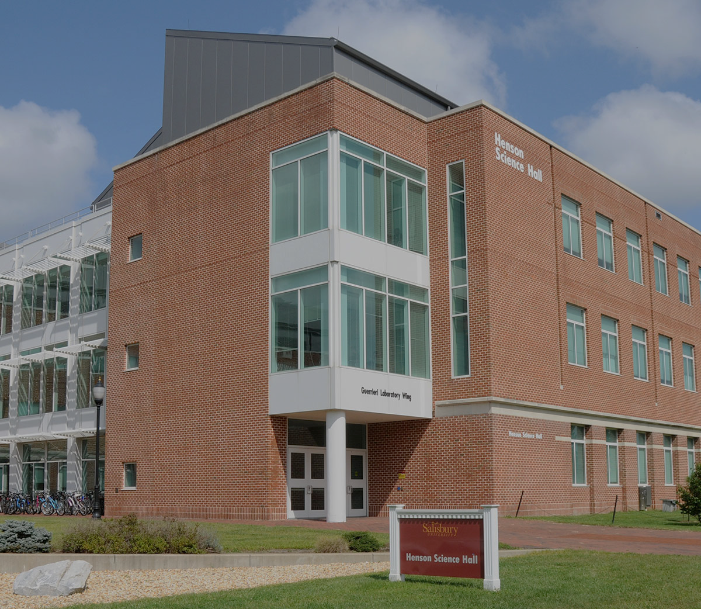
GullHacks Salisbury’s First Ever Hackathon
Introducing
Presented by JJ McCauley
Junior Computer Science Student
Founder of GullHacks

Slide 2
01
What is a Hackathon?
02
Motivations & Goals
TABLE OF CONTENTS
03
Logistics
04
Current Progress
05
Future Outlooks

Slide 3
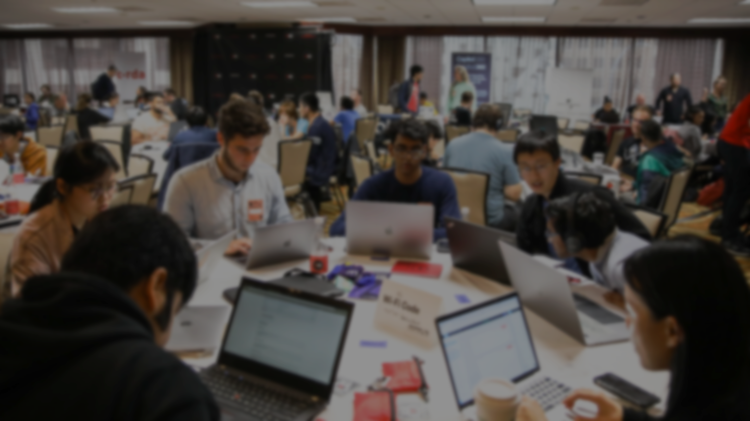

What is a Hackathon?
Coding & Problem-solving Competition
Fixed timeframe, projects are from scratch
Teams of students create projects
Various project ‘themes’
Often includes:
Prizes
Workshops
Mentorship
Recruiting Opportunities
Free food & ‘swag’
Notes:
A hackathon is a time-limited event where individuals or teams collaborate to develop innovative projects, typically related to software or technology. “Creative Marathon”. Projects could be things such as mobile apps, websites, games, AI models, etc.

Slide 4
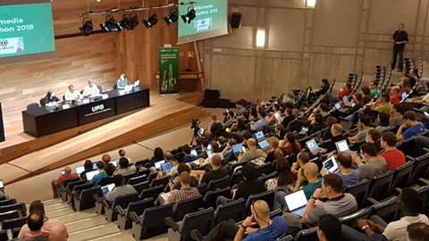
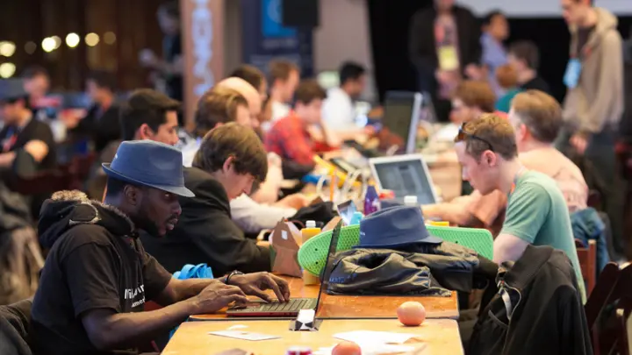
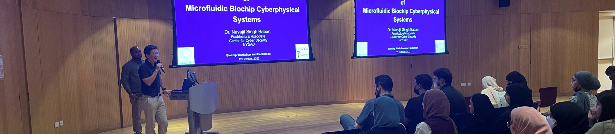
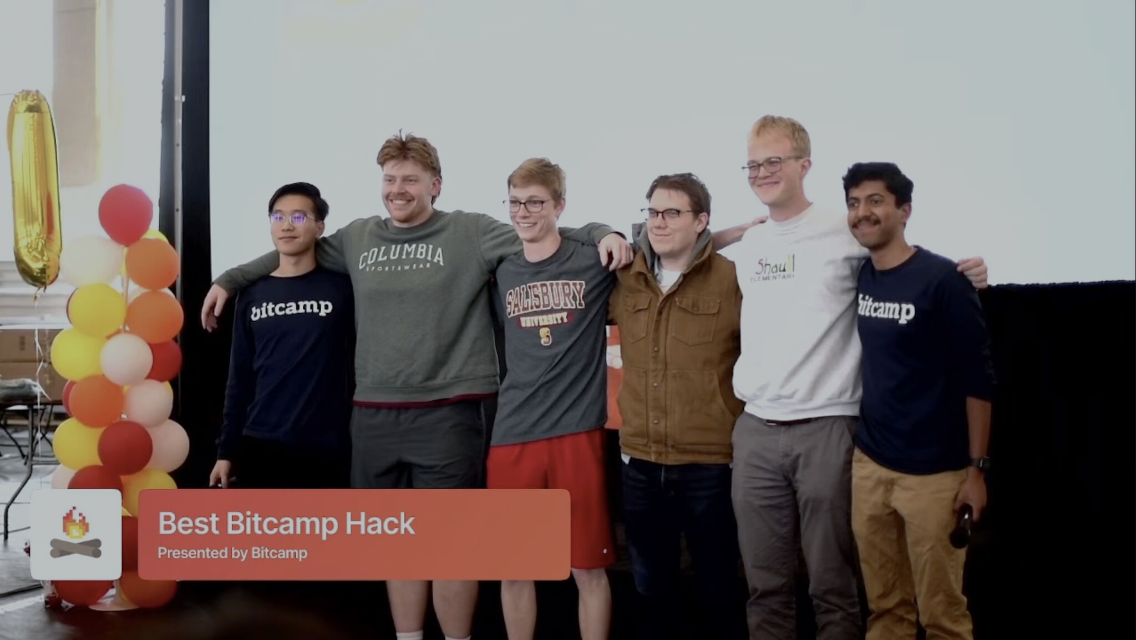
Opening Ceremony
Hacking!
Hackathon Stages
Workshops & Mentorship
Introduction, problem statements, and rules
Coding, designing, collaborating, and prototyping
Mini-sessions to help beginners, support ideas, or provide learning experiences
Closing Ceremony
Final projects are judged, winners are announced, and prizes are awarded
Notes:
Similar to how I will be running it

Slide 5

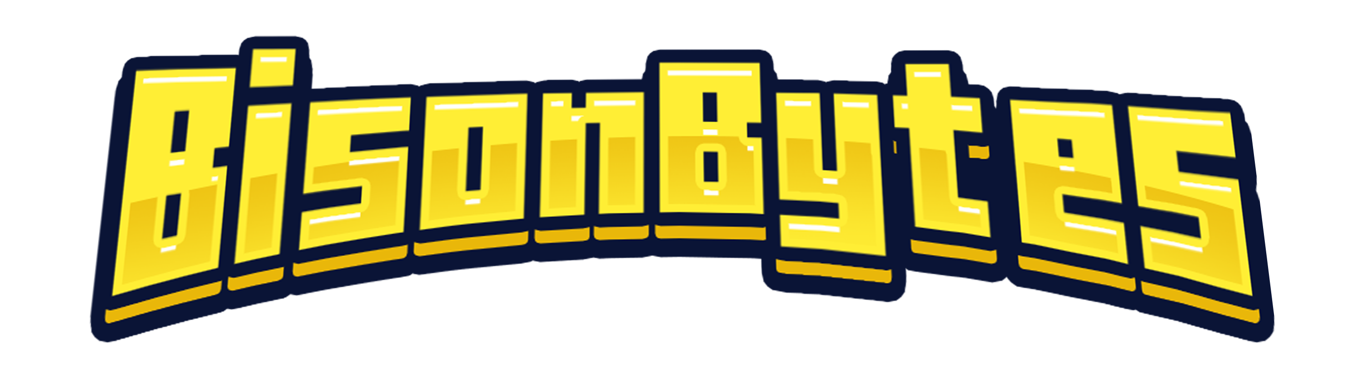



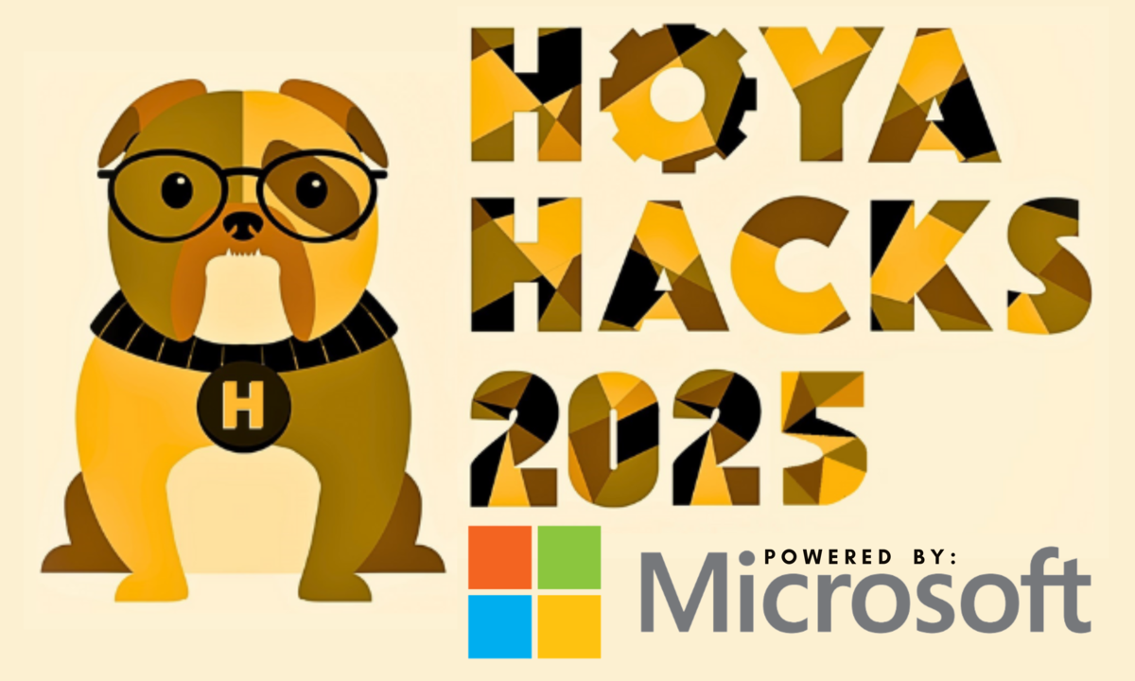
HOPHACKS
BisonBytes
Bitcamp
OTHER UNIVERSITY-BACKED HACKATHONS
HackUMBC
HackPSU
Hoya Hacks
Johns Hopkins University
Baltimore, MD
Howard University
Washington, DC
University of Maryland
College Park, MD
UMBC
Baltimore, MD
Penn State University
University Park, PA
Georgetown University
Washington, DC

Slide 6
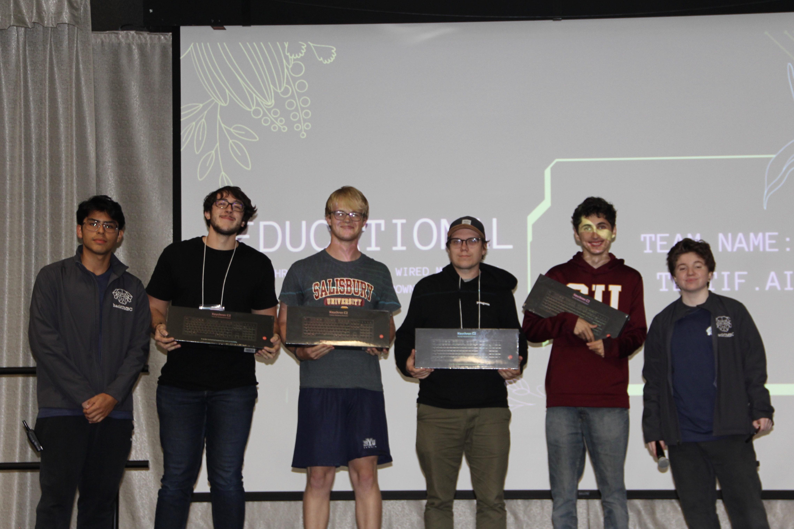
PERSONAL MOTIVATIONS
LEARNING
CONFIDENCE
NETWORKING
Unlike any classroom experience. Very industry-like, on your feet and learning as you do
Reinforces student’s ability with high-pressure situations
Many employers and other helpful students

Slide 7
Enhancing Student Learning
Boosting University Reputation
HACKATHON GOALS
Improving Student Engagement
Driving Research & Innovation
Hands-on experiences, helping students develop industry skills that may not be found as much in the classroom
Well-executed Hackathons attract attention from various companies, recruiters, sponsors, and prospective students
Brings together students, alumni, mentors, and others to foster a positive and collaborate environment
Hackathons serve as a testing ground for new ideas, many of which could evolve into university-backed startup initiatives

Slide 8
Oct. 25th, 2025
EVENT DATE
GENERAL LOGISTICS
12-Hours
HACKATHON DURATION
Henson
BUILDING VENUE
Notes:
8:30am-8:30pm

Slide 9

Website
Logistics
This Semester’s Achievements
Contacted Sponsors
Assembled a Team
Successfully built and deployed website, collaborating with SU webmasters
Wrote detailed proposals with logistical information
Began the process of contacting sponsors, writing letters and creating sponsor tiers
Assembled a team of like-minded students to aid in the execution of the event

Slide 10
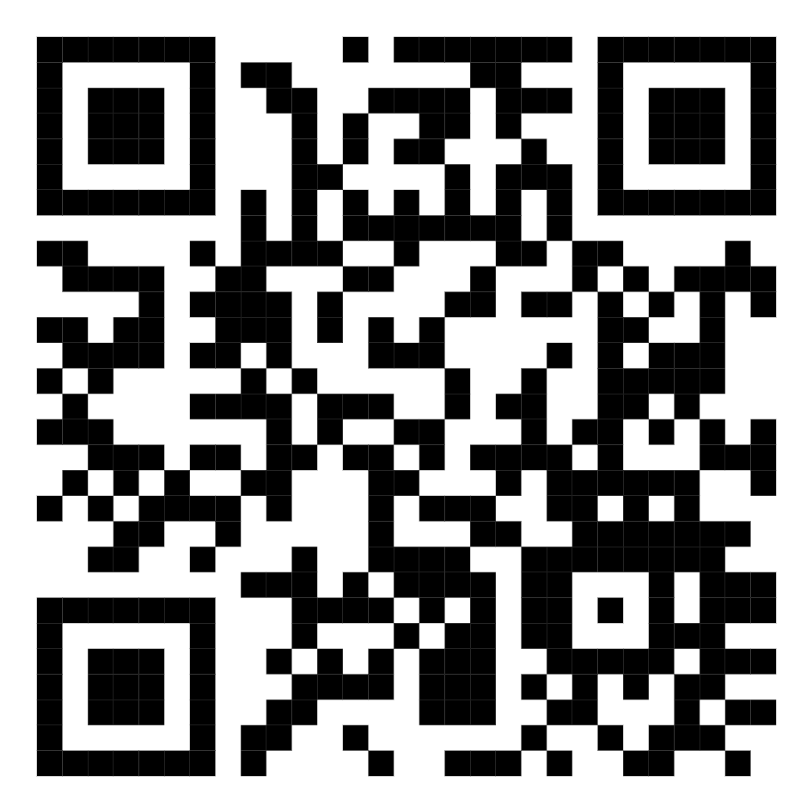
WEBSITE PREVIEW
Preview of the SU Hacks Website, developed in conjunction with the SU webmasters via Wordpress. This ensures that the website can run on SU servers, and that future organizers can easily edit and expand upon the website

Slide 11
TIMELINE
Early June
Early Oct.
Finalize known budget, put in PO orders for known items, build the Devpost page
Aggressive event marketing, Sponsor cutoff date, merch and other resources are obtained
Early May
Early Fall
Oct. 25th
Lock in venues and contact potential sponsors
Offical registration opens, event marketing begins
Day of Hackathon Event!
Notes:
Promotion & Outreach Plan: Class Announcements, Posters & Flyers, Social Media, Emails, and Collaborations with clubs/departments (CS, DS, Info Systems)

Slide 12
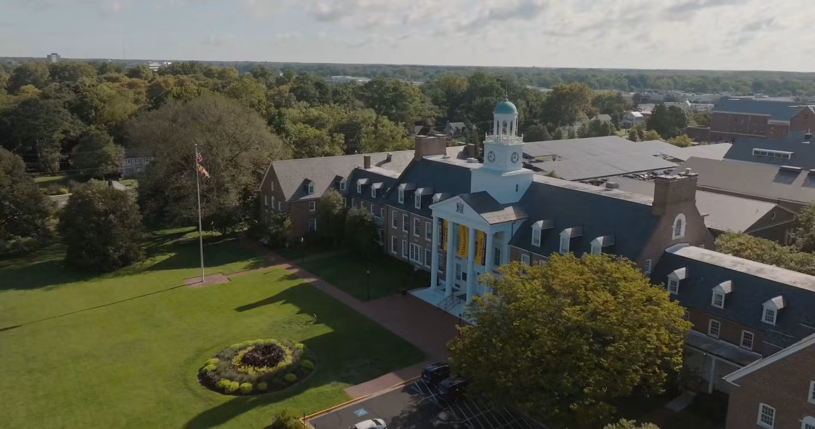
Thank you!
Website
For questions, suggestions, or volunteer inquiries, feel free to contact me at:
jmccauley4@gulls.salisbury.edu Hackathon@salisbury.edu

